Slide 1
Intro to Node Servers & Express

Slide 2
Objectives
To gain a conceptual understanding of server-side code.
To learn the fundamentals of building a server using plain Node.js to listen and respond to client-side requests.
To gain a preliminary understanding of the basic elements of an Express server.
To gain an initial understanding of Express routing.

Slide 3
Darkness...

Slide 4
There is a light(saber) at the end of the tunnel...

Slide 5


Slide 6
How to Survive the Full Stack Apocalypse
Form a study group
Take notes
Ask questions!
Office hours
RTFM

Slide 7
What is a web client?

Slide 8
What is a server?

Slide 9


Slide 10


Slide 11


Slide 12
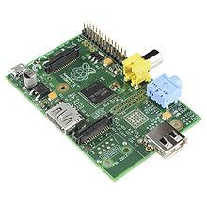

Slide 13


Slide 14
What is localhost?

Slide 15
localhost === this computer

Slide 16


Slide 17
How do a server and web client communicate?

Slide 18
Hyper Text Transfer Protocol

Slide 19
Hypertext is structured text that uses logical links (hyperlinks) between nodes containing text. HTTP is the protocol to exchange or transfer hypertext.

Slide 20
RTFM https://en.wikipedia.org/wiki/Hypertext_Transfer_Protocol

Slide 21
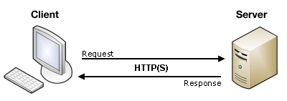
Notes:
Insert server image

Slide 22
What is full stack web development?

Slide 23
Activity: Examples of Server Side Code (5 min)
With your neighbor, find and discuss examples of server side code
Notes:
https://developer.mozilla.org/en-US/docs/Learn/Server-side/First_steps/Introduction

Slide 24
Creating a Server

Slide 25
Creating a Server
For our purposes, “creating a server” equates to writing the code that handles what the server will do
It’s important to note that even though you pay for server-side hardware, you still need to create the code that goes inside.
This code you create handles things like:
Connections to the database
Handling client-side URL requests
Authenticating and logging user requests

Slide 26
Big Box
Your server is an empty box
We will fill it with code and modules to make it do stuff in response to requests

Slide 27
Big Box
Listen for requests
Parse URLs
Based on URL keywords, route logic
Send HTML or JSON files
Receive data (POST requests)
Do cool shit
Listener
n
Parser
Route Handler
Send HTML
Send JSON
Receive POSTs
n
Server Side Logic
And More...

Slide 28
My First Server

Slide 29
Demo: My First Server
Follow along...

Slide 30
var http = require("http");

Slide 31
The http package ("small box") allows our server ("big box") to have the capability of handling requests and responses.

Slide 32
Where did we get ‘http’?

Slide 33
Node standard library

Slide 34
var PORT = 8080;
Notes:
a port is like a portal through which servers and clients communicate

Slide 35
What is a port IRL?

Slide 36
So what is a port in CS?

Slide 37
An endpoint of communication in an operating system

Slide 38
RTFM https://en.wikipedia.org/wiki/Port_(computer_networking)

Slide 39
function handleRequest(request, response) {
response.end("It Works!! Path Hit: " + request.url);
}

Slide 40
Notes:
Insert server image

Slide 41
var server = http.createServer(handleRequest);

Slide 42
The function that's passed in to createServer is called once for every HTTP request that's made against that server, so it's called the request handler

Slide 43
server.listen(PORT, function() {
console.log("Server listening on: http://localhost:%s", PORT);
});
Notes:
Here we start our server so that it can begin listening to client requests.
The below statement is triggered (server-side) when a user visits the PORT URL

Slide 44
In order to actually serve requests, the listen method needs to be called on the server object.

Slide 45
RTFM https://nodejs.org/api/http.html

Slide 46
Activity: Two Servers
See 02-Two-Servers for instructions

Slide 47
Review: Two Servers

Slide 48
Routing

Slide 49
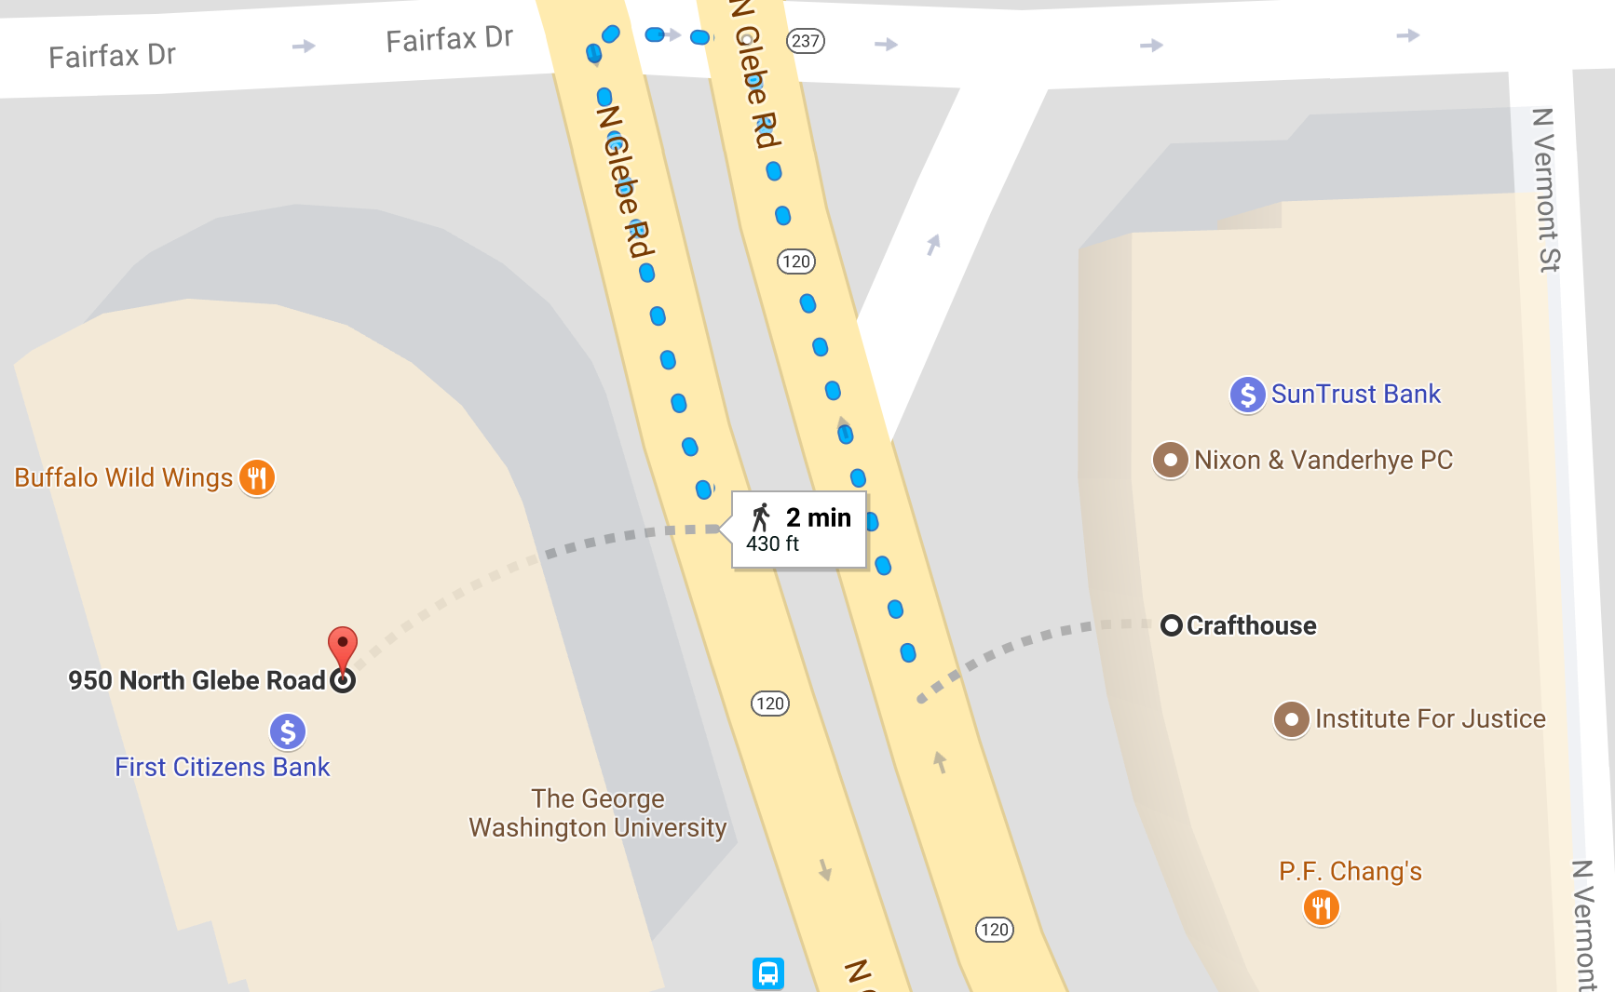

Slide 50
maps.google.com

Slide 51
How an application responds to a client request

Slide 52
What is a URL?

Slide 53
Uniform Resource Locator

Slide 54
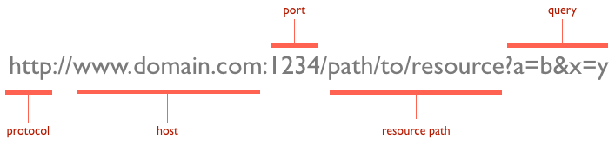

Slide 55
RTFM https://developer.mozilla.org/en-US/docs/Learn/Common_questions/What_is_a_URL

Slide 56
Demo: Portfolio
Open 03-Portfolio
$ node server.js
The url library is needed to parse the requested URL.
We use the abbreviated terms req and res, which are short for request and response.
We use a switch-case statement which routes the code to a different function depending on the URL provided.
Finally, the way in which we created HTML dynamically and rendered it on the page in each function.

Slide 57
Activity: Portfolio (5 min)
Explain 03-Portfolio/server.js to your friends and neighbors

Slide 58
Demo: Serving HTML
Open 04-Serving-HTML
What’s going to happen?

Slide 59
Activity: Serving HTML (5 min)
Discuss 04-Serving-HTML/* with your friends and neighbors

Slide 60
Demo: Serve Favorites
$ node 05-Serve-Favorites/server.js

Slide 61
Activity: Serve Favorites (30 min)
See 05-Serve Favorites for instructions

Slide 62
Review: Serving Favorites
We created the basic skeleton of a Node server (requiring: url && http; port)
We set up a listener to initiate the server's handling of requests.
We created a function handleRequest which takes in a request URL, parses it, then relays the user to the correct page.

Slide 63
Activity: Lunch
Download and install Postman https://www.getpostman.com/

Slide 64
HTTP Methods

Slide 65
GET vs. POST
Two commonly used methods for a request-response between a client and server are: GET and POST.
GET - Requests data from a specified resource
POST - Submits data to be processed to a specified resource

Slide 66
Demo: Request Methods
This app is going to log the type of request it receives, along with any information that was sent with the request
Open Postman
$ node 06-Request-Methods/server.js
Send requests

Slide 67
Activity: POST Requests (20 min)
You will create a server that will accept POST requests
See 07-POST-Method for instructions

Slide 68
Review: POST Requests
POST routes are effectively endpoints that client-side code can use to send data to the server.

Slide 69
Express

Slide 70
Express is a framework for Node to simplify server code

Slide 71
https://expressjs.com/

Slide 72
What is a route?

Slide 73
Demo: Routes
http://nyt-mongo-scraper.herokuapp.com/
User visits “/” route (GET)
User visits “/saved” (GET)
Request triggers the code in the server route
Server responds by returning HTML with saved articles
User saves an article using “/api/headlines” (POST)
Request triggers the code in the server route which sets article to saved in db
Saved articles are loaded in HTML

Slide 74
Demo: Routing
http://starwars-express.herokuapp.com/
Also http://starwars-express.herokuapp.com/api
The API accepts an additional parameter at the end of the URL.
For example http://starwars-express.herokuapp.com/api/yoda
$ node 08-StarWars-1/server1.js
http://localhost:3000/
http://localhost:3000/yoda

Slide 75
var app = express();

Slide 76
Creates an Express application

Slide 77
Activity: The Phantom Menace (5 min)
See 08-StarWars-1 for instructions

Slide 78
Review: 08-StarWars-1/server1.js
var obiwankenobi = { name: "Obi Wan Kenobi", role: "Jedi Knight", age: 42, forcePoints: 1350 } app.get('/obiwankenobi', function(req, res){ res.json(obiwankenobi); })

Slide 79
Activity: Attack of the Clones (5 min)
See 09-StarWars-2 for instructions

Slide 80
Review: 09-StarWars-2/server2.js
We created an array of character objects
/:characters syntax is a way of saying we have a "variable" parameter in the URL route
Pass the route to variable chosen using req.params.characters
See console
Notes:
https://stackoverflow.com/questions/14417592/node-js-difference-between-req-query-and-req-params

Slide 81
Activity: Revenge of the Sith
See 10-StarWars-3 for instructions

Slide 82
Review: 10-StarWars-3/server3.js
http://localhost:3000/api/yoda
http://localhost:3000/api/hansolo

Slide 83
?

Slide 84
This parameter is optional

Slide 85
http://localhost:3000/api

Slide 86
req.params. ...

Slide 87
Creates a route parameter

Slide 88
for?

Slide 89
This for-loop "checks" which character is being sought after in the URL -- then finds that character's information and re-displays it back to the user in the form of a JSON

Slide 90
Where might we find routing like this?

Slide 91
https://www.washingtonpost.com/business/technology/andrew-ng-hates-paranoid-androids-and-other-fun-facts/2017/08/21/ce4cdb02-8697-11e7-96a7-d178cf3524eb_story.html?utm_term=.e714dbbc6455

Slide 92


Slide 93
Demo: Homework
$ node /Users/jarednielsen/FullStack-Lesson-Plans/01-Class-Content/13-express/02-Homework/Solutions/FriendFinder/server.js
http://localhost:8080/
You will build a dating application or compatibility test.
In essence, the application saves each user's survey responses in the database, then compares the responses against everyone in the database to identify the best match.

Slide 94
Further Reading
https://nodejs.org/en/docs/guides/anatomy-of-an-http-transaction/
https://developer.mozilla.org/en-US/docs/Learn/Server-side/First_steps/Introduction
https://developer.mozilla.org/en-US/docs/Web/HTTP/Methods
https://www.quora.com/Why-is-80-a-special-port-in-localhost
https://developer.mozilla.org/en-US/docs/Learn/Server-side/Express_Nodejs
https://developer.mozilla.org/en-US/docs/Web/HTTP/Methods
https://www.w3schools.com/tags/ref_httpmethods.asp

